Slide 1


Slide 2

Major Project-I (01CE0716)
Review 1 (12/07/2025)
TITLE: EventEase – Smart Event Planning and RSVP Web App
Team ID: 7CE_074
Team Member 1: Sadab Hussain (92201703107) (7-EC3)
Team Member 2: Sahil Kumar (92201703152) (7-EC3)
Team Member 3: Arshad Ali (92201703075) (7-EC3)
Guided By
Internal Guide Name: Prof. Sweta Khatana
Department of Computer Engineering, Faculty of Engineering & Technology

Slide 3
Outline
Abstract
Introduction
System Analysis / Literature Review
Project Flow Chart / System Design
ER Diagrams / Use Case diagrams etc.
Proposed Solution / System
Tools & Technology to be used
Project Scheduling (Gantt Chart)
Expected Outcomes
Conclusion
References

Slide 4
Abstract
EventEase – Smart Event Planning and RSVP Web App is an innovative web application designed to streamline and enhance the process of event planning and guest management for individuals and organizations. The platform supports a wide range of event types, including birthday parties, weddings, anniversaries, corporate meetings, and social gatherings — providing a one-stop solution tailored to each unique occasion.
EventEase offers an intuitive interface where users can create and customize events by selecting services and adding details such as decoration themes, food preferences, seating arrangements, and audio/visual setups. Predefined packages with optional add-ons allow hosts to personalize events according to their budget and style.
A key feature of the platform is its real-time RSVP tracking system, which enables guests to confirm attendance, specify dietary preferences, and stay updated with any changes in schedule or venue. Automatic reminders and live updates help minimize miscommunication and improve attendance rates. Additionally, hosts have access to a real-time dashboard displaying guest statuses — confirmed, declined, or pending — enabling efficient and hassle-free event management.

Slide 5
Introduction
In today’s fast-paced digital era, organizing events efficiently demands far more than traditional invitation methods or manual guest lists. With growing expectations for convenience, accuracy, and real-time updates, event hosts often struggle to coordinate multiple tasks — managing guest details, tracking RSVPs, sending timely reminders, and handling last-minute changes — all of which can quickly become tedious, error-prone, and stressful.
EventEase addresses these challenges by providing a centralized, intuitive platform that empowers individuals and organizations to plan, customize, and monitor events of any scale with ease and reliability. By integrating real-time RSVP tracking, smart notifications, and a user-friendly dashboard, EventEase simplifies the entire process — saving time, reducing miscommunication, and ensuring a seamless experience for both hosts and guests.

Slide 6
System Analysis / Literature Review
The evolution of web technologies and real-time data processing has transformed online event management solutions over the past decade. Popular platforms like Eventbrite and Meetup highlight the increasing demand for digital tools that simplify guest coordination, invitation management, and live updates.
Studies indicate that features such as real-time RSVP tracking, dietary preference collection, and automated reminders significantly enhance guest engagement and reduce the likelihood of no-shows.
Despite these advances, many existing solutions lack comprehensive customization options and seamless, centralized management for diverse event types. EventEase addresses these gaps by combining the flexibility of full-stack web development with an intuitive interface, offering users a smart, end-to-end platform for personalized, reliable, and efficient event planning.

Slide 7
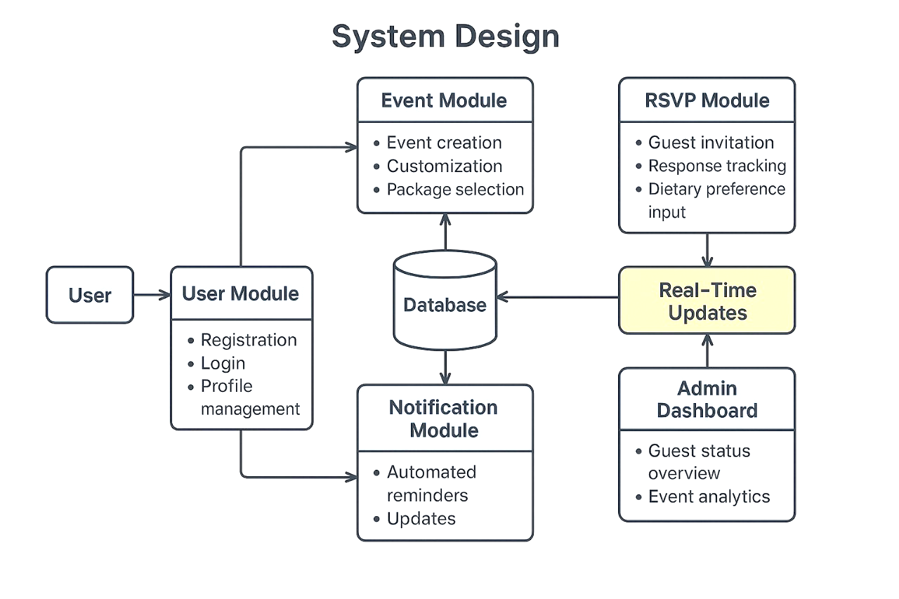
Project Flow Chart / System Design

Slide 8
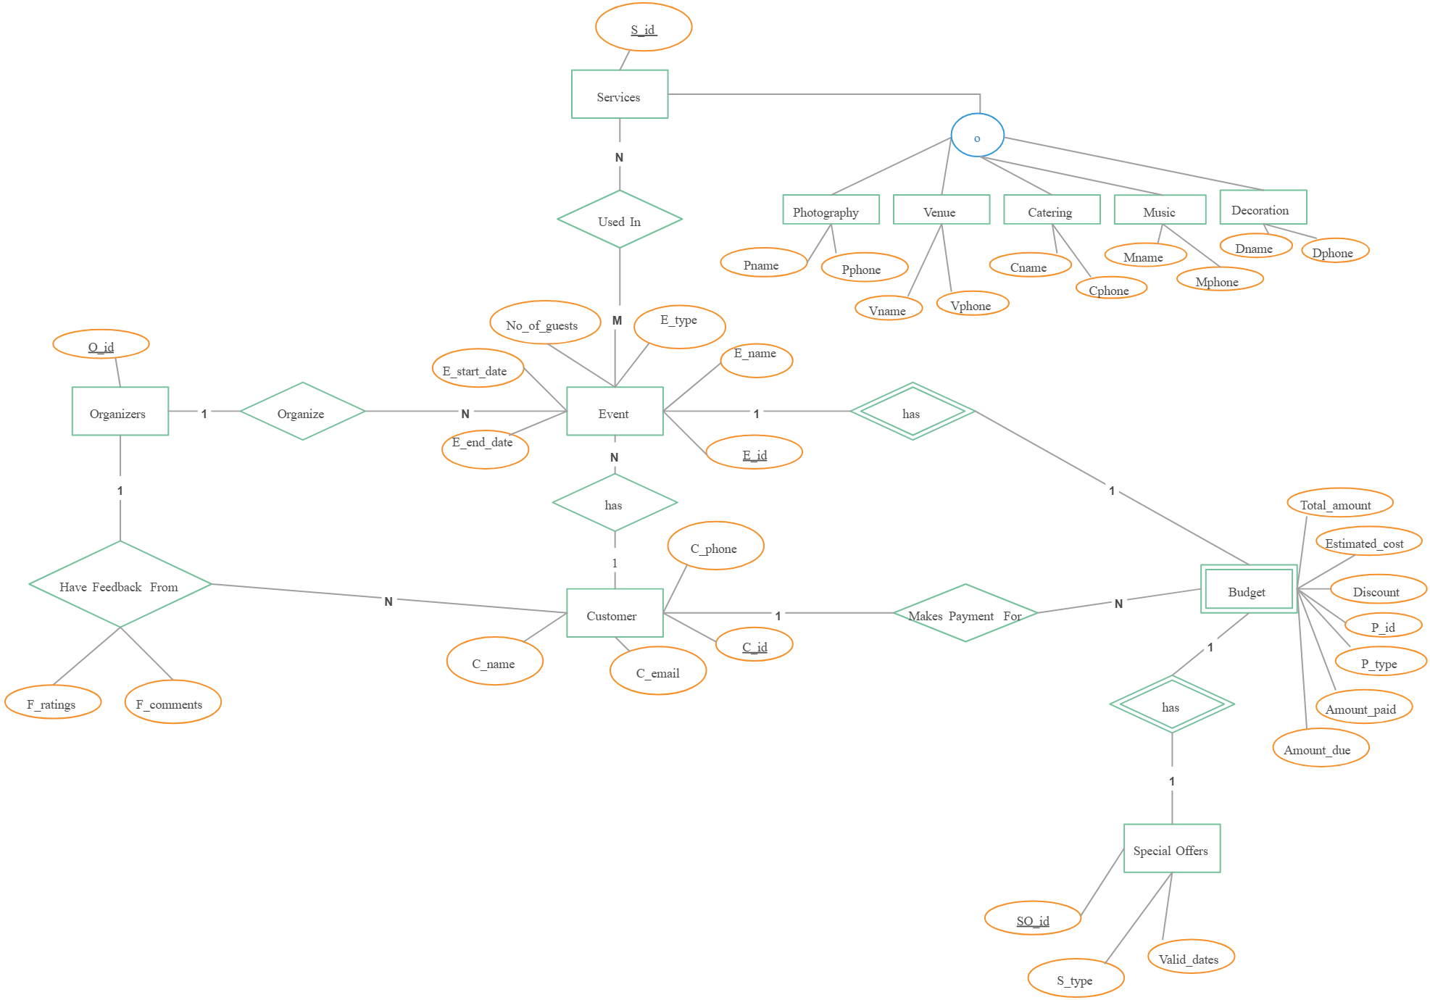
ER Diagram

Slide 9
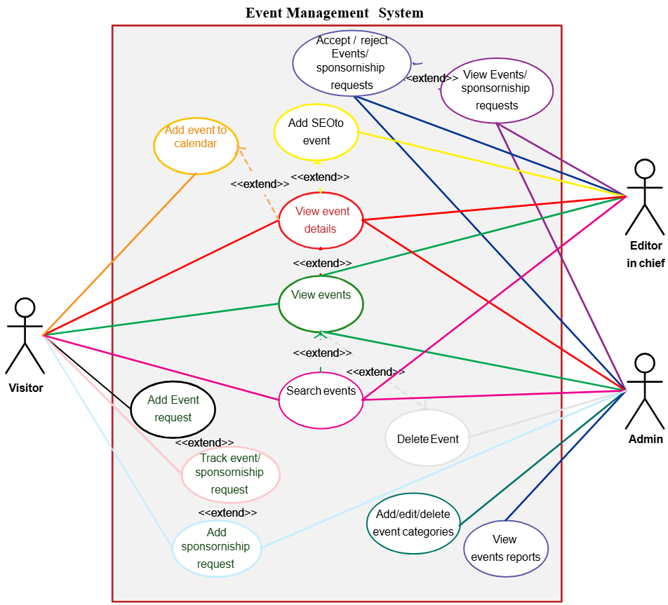
Use Case diagram

Slide 10
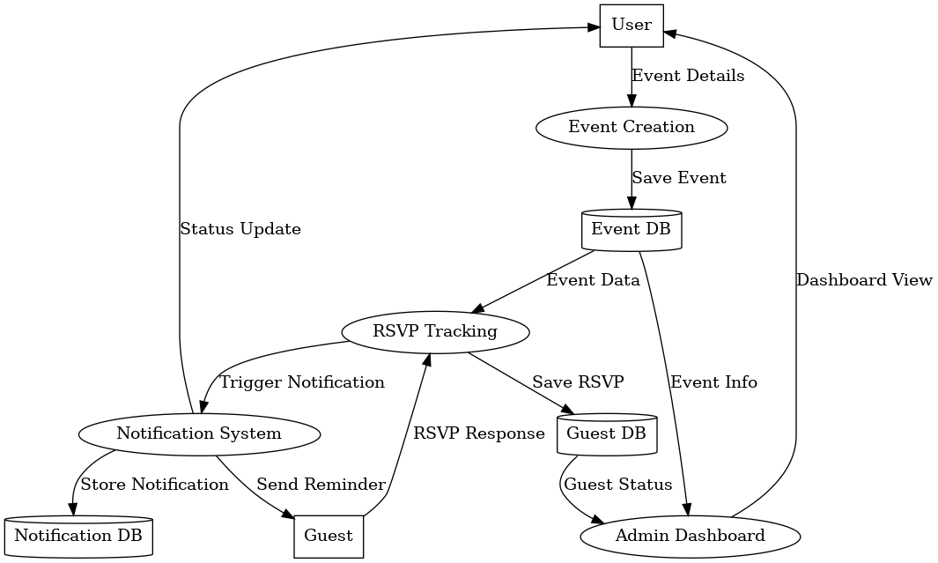
DFD diagram

Slide 11
Proposed Solution
EventEase provides a comprehensive, one-stop solution for smart and efficient event planning. The platform integrates customizable event creation, dynamic guest management, and real-time updates, eliminating the hassle of manual coordination.
Users can easily create events, choose service packages, and personalize details such as themes, food preferences, and seating arrangements. Guests receive digital invitations, can RSVP online, specify dietary needs, and get instant notifications for any updates related to the event’s schedule or venue.
Automated confirmations, smart reminders, and a live dashboard ensure hosts always have up-to-date guest information at their fingertips. By combining modern web technologies with an intuitive interface, EventEase reduces planning time, minimizes miscommunication, and enhances the overall experience for both hosts and attendees — delivering smooth, reliable, and memorable events every time.

Slide 12
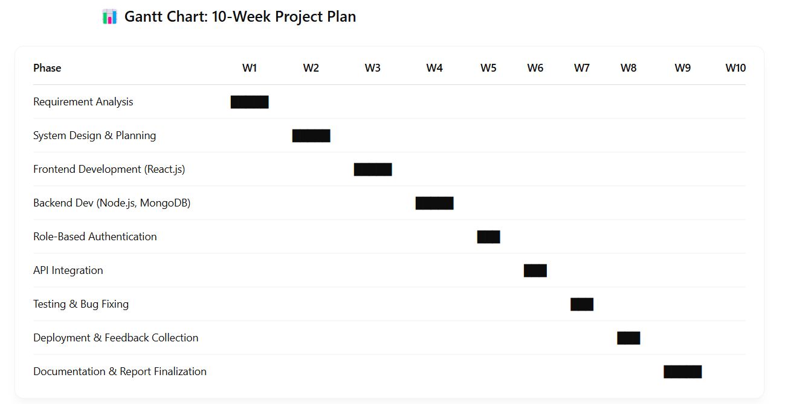
Project Scheduling (Gantt Chart)

Slide 13
Tools & Technology to be used
Here in this we have created the website with the help of MERN stack
i.e. MongoDB, Express.js, React and Node.js.
Frontend: React.js, React Bootstrap
Backend: Node.js, Express.js
Database: MongoDB
Deployment: Vercel, GitHub for version control
Other: RESTful APIs, JWT for authentication, cloud services for notifications

Slide 14
Expected Outcomes
A fully functional, responsive web application for planning and managing diverse events.
Improved guest engagement through real-time RSVP tracking, dietary preference handling, and smart reminders.
Reduced miscommunication with automated updates for schedule or venue changes.
A user-friendly interface accessible seamlessly on desktops, tablets, and mobile devices.
A secure, scalable system with robust data handling for guest and event information.
Time and effort savings for hosts through centralized event management tools.
Increased attendance rates and better event coordination through live dashboards and notifications.
A positive, streamlined experience that benefits both event organizers and guests.

Slide 15
Conclusion
EventEase aims to revolutionize the way events are planned and managed by providing an all-in-one, smart, and scalable solution. By combining the power of modern web technologies with thoughtful user experience design, the platform simplifies complex tasks and ensures seamless communication, ultimately delivering a stress-free and memorable event experience for all users. With its real-time RSVP tracking, automated reminders, and personalized features, EventEase saves time, reduces manual errors, and boosts guest satisfaction. The system’s flexible design ensures it can adapt to a wide variety of event types, from private celebrations to corporate gatherings, making it a versatile tool for individuals and organizations alike.
In the future, EventEase can be further enhanced with advanced analytics, AI-based recommendations, and integrations with third-party services, paving the way for smarter, data-driven event management.

Slide 16
References
National Institute of Standards and Technology (NIST), “Guidelines on Digital Evidence Examination,” 2020. [Online]. Available: https://www.nist.gov/
MongoDB Documentation, “MongoDB Database System Guide,” 2024. [Online]. Available: https://www.mongodb.com/docs
Express.js Documentation, “Express – Fast, unopinionated, minimalist web framework for Node.js,” 2024. [Online]. Available: https://expressjs.com/
React Documentation, “React – A JavaScript Library for Building User Interfaces,” 2024. [Online]. Available: https://reactjs.org/docs/getting-started.html
Node.js Documentation, “About Node.js,” OpenJS Foundation, 2024. [Online]. Available: https://nodejs.org/en/docs
Bootstrap Documentation, “Bootstrap – The most popular HTML, CSS, and JS library,” 2024. [Online]. Available: https://getbootstrap.com/docs/

Slide 17


Slide 18


